Slide 1
INTRODUCTION TO WEB
Web Fundamentals Workshop

Slide 2
Topics :
Web Vs Internet
How the web works
Protocols, servers and api
Database
Web development
Ways to create a website

Slide 3
Web Vs Internet
Web
Internet
The web is one of the means of sharing information on the internet
the web is made up of billions of connected digital documents that are displayed in a web browser
Internet is a worldwide network of billions of servers, hardware peripheral computers
Internet is a worldwide network resulting from the meeting of several networks and uses the TCP / IP protocol.
Vs

Slide 4
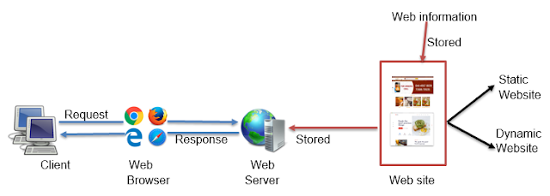
How the web works

Slide 5
Protocols, servers and API
A protocol is a standard method that allows communication between processes (possibly running on different machines), that is to say a set of rules and procedures to be followed to send and receive data on a network. There are several depending on what is expected of the communication. Some protocols will, for example, be specialized in exchanging files (FTP), others can be used to simply manage the state of transmission and errors (this is the case of the ICMP protocol), ... On the Internet, the protocols used are part of a series of protocols, that is to say a set of protocols linked together. This protocol suite is called TCP / IP.
A server is a high-power computer which is responsible for providing the service of transmission of information requested by its clients, which may be other computers, mobile devices or even printers. Web servers are a component of servers whose main function is to store, in a web hosting, all the files of a web page (images, texts, videos, etc.) and to transmit them to users through browsers. using HTTP protocol
An API, for Application programming interface, is a program that allows two separate applications to communicate with each other and exchange data. In particular, this avoids having to recreate and entirely redevelop an application to add its information. For example, it is there to make the link between already existing data and an independent program

Slide 6
Database
is an organized collection of structured information
supports data storage and manipulation
simplifies data management
can be easily accessed, managed, modified, updated, controlled, and organized
The best database for a specific organization depends on the organization's goals, plans and projects

Slide 7
Database
Today, the number 1 databases are :
SQL ( Structured Query Language )
NoSQL ( Not only SQL )
Cloud

Slide 8
Web development
Web development is the building and maintenance of websites; it’s the work that happens behind the scenes to make a website look great, work fast and perform well with a seamless user experience.
Web developers, or ‘devs’, do this by using a variety of coding languages. The languages they use depends on the types of tasks they are preforming and the platforms on which they are working.

Slide 9
Ways to create a website
2 ways to create a website
CMS « Content management system »
Hard coding

